Slide 1
Managing Networking
Identify TCP/IP Fundamentals
Identify Linux Server Roles
Connect to a Network
Configure DHCP and DNS Client Services
Configure Cloud and Virtualization Technologies
Troubleshoot Networking Issues

Slide 2
TCP/IP
The networking protocol that governs Internet communications and many other modern computer networks.
Has rules that control:
How much info to communicate.
What addresses represent what nodes.
How nodes communicate on the network.
What error checking exists.
And more.
The only protocol suite of note.

Slide 3
The OSI Model (Slide 1 of 2)
A standard that defines how networking is meant to function in terms of different layers.
7 layers.
Each represents an area of responsibility.
You need to memorize the layers.
Used as a reference point.
Example: Purchase a "Layer 2" switch.
Example: Troubleshoot a "Layer 3" problem.

Slide 4
The OSI Model (Slide 2 of 2)
Layer | Name | Basic Function
7 | Application | Supports apps and end-users.
6 | Presentation | Formats data for use.
5 | Session | Manages connections.
4 | Transport | Enables reliable transmission.
3 | Network | Enables logical addressing.
2 | Data link | Enables physical addressing.
1 | Physical | Enables physical connectivity.

Slide 5
TCP/IP Layers (Slide 1 of 2)
4 TCP/IP layers satisfy 7 OSI layers.
TCP/IP used by Linux and other major OSes.
You need to understand suite and layers.
Can aid in troubleshooting.

Slide 6
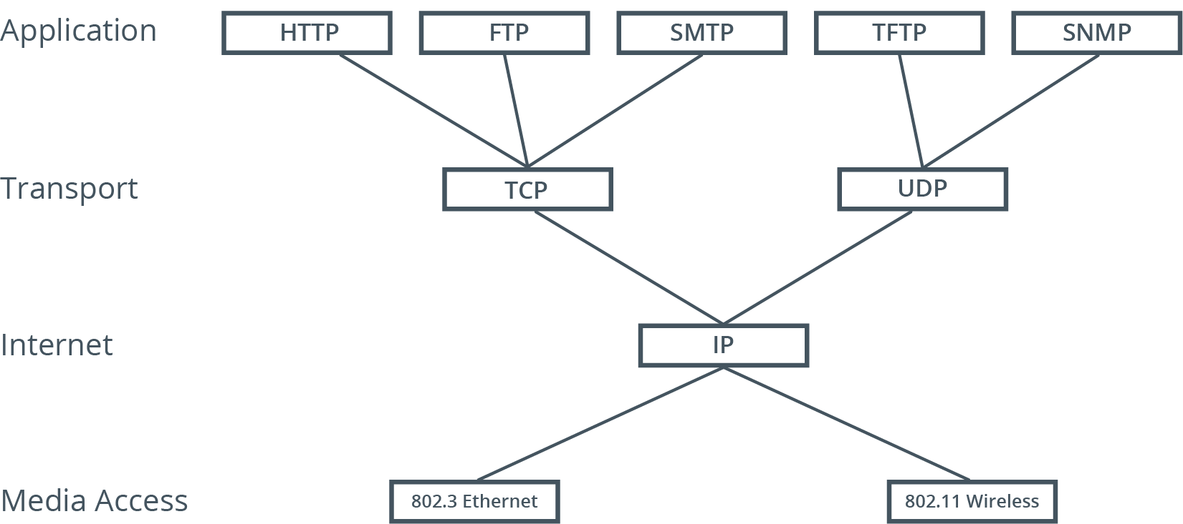
TCP/IP Layers (Slide 2 of 2)

Slide 7
Network Identities
Identifier | Description
MAC address | Unique identity on each NIC. Physical address.
IP address | Logical address. Identifies NIC in network. Show in dotted decimal; computer uses binary.
Hostname | Human-readable name. Also called computer name.

Slide 8
Network Devices and Components
Device/Component | Description
Switch | Centralizes connections for a segment. Can manage traffic. Usually operate at Layer 2.
Router | Controls communications between segments. Can allow or deny certain traffic. Operate at Layer 3.
Media | Usually twisted pair Ethernet cable. Also coaxial and fiber optic cable. Wireless networks forgo cables.

Slide 9
DNS and DHCP
DNS provides name resolution.
Relates hostname with IP address.
Implemented as database on servers.
Can be internal to a network or part of Internet infrastructure.
DHCP provides dynamic configuration of IP addresses.
Nodes need addresses to communicate.
Dynamic configuration more typical in end-user workstations.
Static configuration typical in servers.

Slide 10
IPv4 Addressing
Provides system for managing network identities.
IPv4 address is 32 bits long.
4.3 billion addresses total.
Humans work with address in decimal (e.g., 192.168.2.200).
Computers work with address in binary.
Divided into two portions.
Network identifier defines segment host is on.
Host identifier defines host within that segment.
Subnet mask shows what portion is network ID, what portion is host ID.

Slide 11
IPv4 Classes
Class | Start Addr. | End Addr. | Networks | Hosts per Network | Default Subnet Mask
A | 0.0.0.0 | 127.0.0.0 | 126 | 16,777,214 | 255.0.0.0 or /8
B | 128.0.0.0 | 191.255.0.0 | 16,384 | 65,534 | 255.255.0.0 or /16
C | 192.0.0.0 | 223.255.255.0 | 2,097,152 | 254 | 255.255.255.0 or /24
D | 224.0.0.0 | 239.255.255.255 | N/A | N/A | N/A
E | 240.0.0.0 | 255.255.255.255 | N/A | N/A | N/A

Slide 12
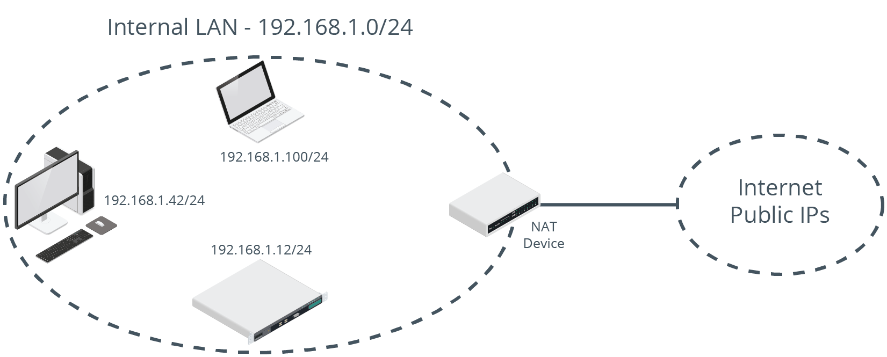
Reserved Ranges

Slide 13
IPv6
IPv4 has many limitations.
IPv6 is its eventual replacement.
Advantages:
Larger address space.
Built-in encryption.
More efficient routing.
Linux is fully compatible with IPv6.

Slide 14
Network Ports
An endpoint in network communication that identifies the type of application-layer protocol used in a communication.
Devices use port numbers to understand how to handle communications.
Port numbers map to application-layer protocols.
Common ports:
22: SSH
25: SMTP
80: HTTP
110: POP3
443: HTTPS

Slide 15
Network Segments (Slide 1 of 2)
Divide network into segments for easier management.
Better performance.
Better security.
Logical divisions are called subnets.
Identified by network ID.

Slide 16
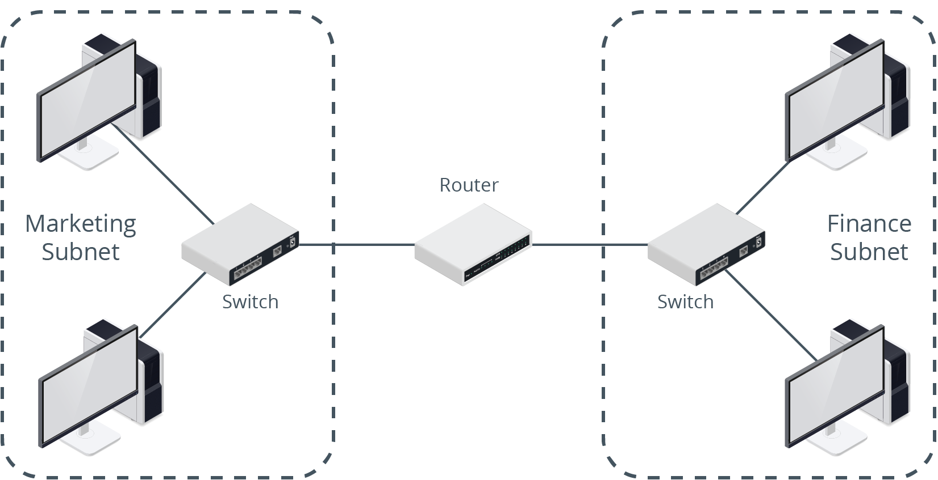
Network Segments (Slide 2 of 2)

Slide 17
Activity: Identifying TCP/IP Fundamentals
You need to review TCP/IP before configuring networking info.
You'll be better equipped to manage Linux networking.

Slide 18
NTP Services (Slide 1 of 2)
A network protocol that synchronizes a node's time with a designated, definitive time source.
Essential in networking.
Linux systems can be NTP sources or clients.
Uses UDP port 123.

Slide 19
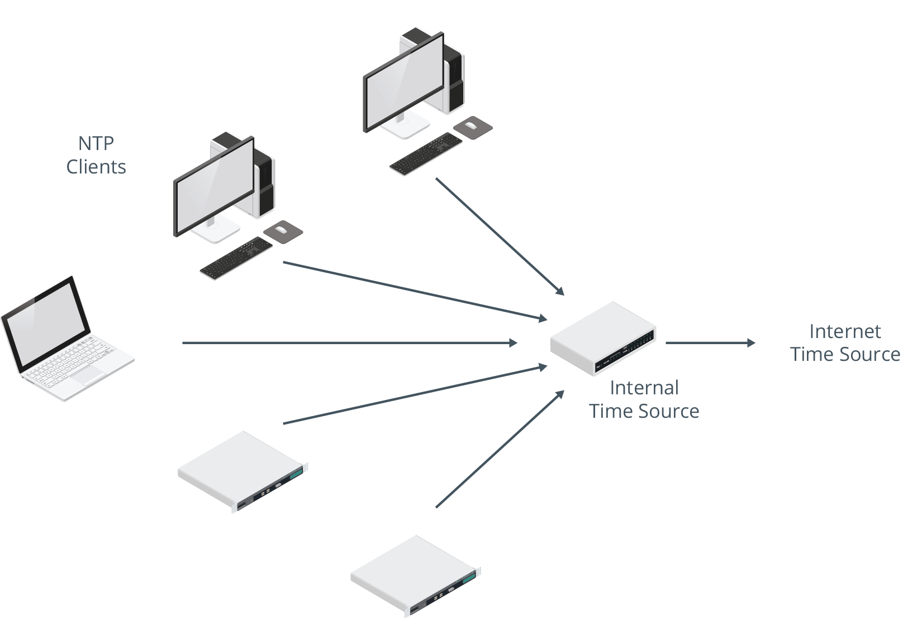
NTP Services (Slide 2 of 2)

Slide 20
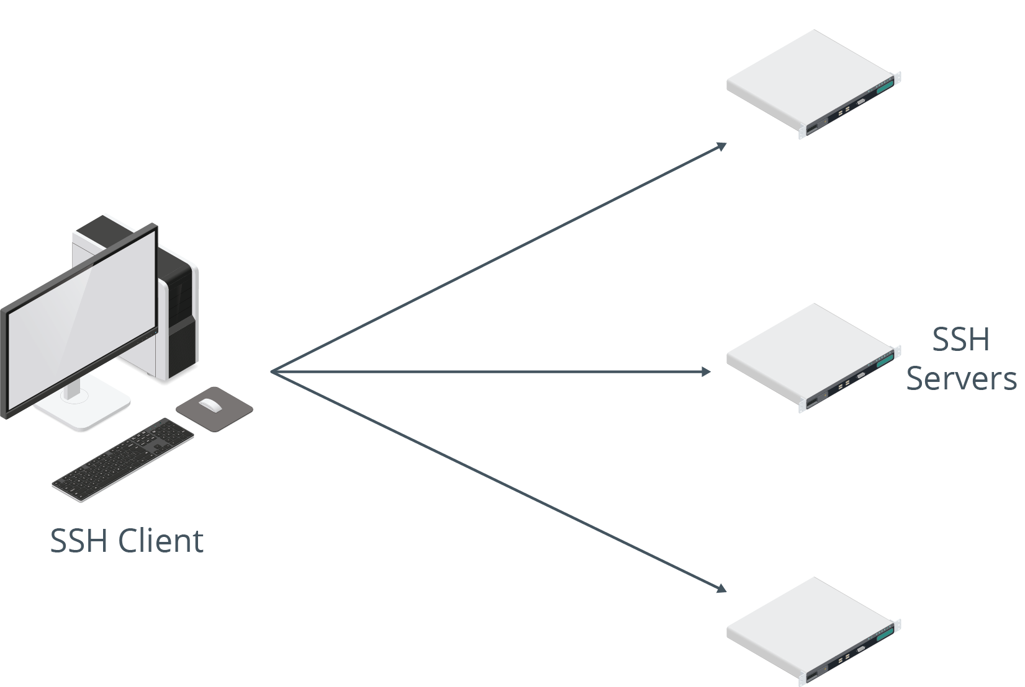
SSH Services
Provides authenticated, encrypted connection to a system.
Used for remote administration.
Can also be used to tunnel other network communications.
Linux can be SSH client and/or server.
Uses TCP port 22.

Slide 21
Web Services
Hosts files and images making up a website.
Clients connect to web server to download files.
Web servers are very common on Linux.
Typically hosted through Apache.
HTTP uses TCP port 80.
HTTPS uses TCP port 443.

Slide 22
Certificate Authority Services
A server that can issue digital certificates and the associated public/private key pairs.
Certificates guarantee identity in a public key infrastructure (PKI).
CA manages enrollment, approval, revocation, etc., for certificates.
Example: Used in HTTPS connections.
Linux servers can be CAs.

Slide 23
Name Server/DNS Services
A network protocol for translating human-readable hostnames into IP addresses.
Can contain records for company's internal network.
Can be part of wider Internet name resolution infrastructure.
Linux can be DNS servers and/or clients.
Uses TCP/UDP port 53.

Slide 24
DHCP Services
A network protocol used to automatically assign IP addressing information to hosts.
Sends address, subnet mask, default gateway, etc.
Client leases configuration from DHCP server.
Linux can be DHCP server or client.
Uses UDP ports 67 and 68.

Slide 25
SNMP Services
A network protocol for collecting and passing device information between hosts.
No longer common due to security concerns.
Linux can be a central SNMP server or an SNMP device.
Uses UDP port 161 and TCP/UDP port 162.

Slide 26
Authentication Services
Centralized authentication makes network:
More secure.
Simpler to manage.
Easier for users to navigate.
Servers hold info about user identities.
User login credentials are compared to stored identity info.
Many kinds of authentication used on Linux.
Examples: Kerberos and LDAP.

Slide 27
Proxy Services
Resides on a system with both trusted and untrusted connections.
Passes Internet requests between two networks.
Example: Web proxy.
Client passes requests to proxy.
Proxy connects to Internet to satisfy request.
Info returned to proxy.
Proxy passes info back to client.
Linux can be proxy server.
Example software: Squid.

Slide 28
Logging Services
Admins need to be aware of how server is operating.
Logs provide info about boot, service performance, user behavior, etc.
Several logging services available for Linux.
Logs can be centralized.
Systems forward logs to one server.
Easier to archive, troubleshoot, audit, etc.

Slide 29
Monitoring Services
Many available in Linux.
Some monitor specific apps, others monitor entire OS.
Examples:
top
ApacheTop
Monit
System Monitor

Slide 30
Load Balancing Services
The technique of distributing network traffic or computing workload among multiple devices in a network.
Often used with web server infrastructure.
Web server can easily be overwhelmed.
Load balancing ensures connections are spread across multiple servers.

Slide 31
Clustering Services
The technique of connecting systems together to perform tasks as if they were one system.
Often used with databases in a SAN.
Each cluster is a node and can accept connections.
If one node goes down, other nodes in cluster maintain availability.

Slide 32
File/Print Services
Very common in most networks.
File servers centralize user data.
Better backups.
Better security.
Greater fault tolerance.
Easier access.
Printing can also be centralized.
More efficient.
More cost savings.
Easier to manage paper/toner supplies.

Slide 33
Database Services
Stores large quantities of data.
Enables querying/retrieval of data.
SQL database:
Uses relational tables.
Examples: MySQL, MariaDB, PostgreSQL.
NoSQL database:
Does not use relational tables.
Example: MongoDB.

Slide 34
VPN Services
A method of extending a private network by tunneling through a public network, such as the Internet.
Enables remote users to access internal resources over the Internet.
Useful for users working at home or on the road.
Important because certain networks are untrusted.
VPN encrypts content on client end.
Content decrypted on server end.
Linux can be a VPN server or client.

Slide 35
Virtualization/Container Host Services
Virtual machines (VMs):
Virtualize computer hardware.
Layer of software resides on top of hardware and manages resource allocation.
OSes can be installed in VMs.
Provides same functionality as physical server.
Save on cost and are more efficient to manage.
Example software: Kernel-Based Virtual Machine (KVM).
Containers:
Single host OS runs multiple apps in isolation.
All apps share OS and its resources.
Improve efficiency and management.
Example software: Docker.

Slide 36
Email Services
Key component of business communications.
Distribute electronic mail within or between organizations.
Example Linux services: Sendmail and Postfix.
Protocols:
SMTP (TCP port 25).
POP3 (TCP port 110).
IMAP (TCP port 143).

Slide 37
Activity: Identifying Linux Server Roles
Develetech help desk wants you to address networking questions.
You'll get a better idea of what server roles you may need.

Slide 38
Hostname Configuration
systemd uses hostnamectl set-hostname to configure hostname.
Must restart service after hostname is changed.
Example:
sudo hostnamectl set-hostname server01

Slide 39
IP Configuration
IP address must be configured on system to use the network.
Also includes subnet mask, default gateway, DNS server(s), etc.
Verify this info early on in troubleshooting process.
Misconfiguration may result in lack of network connectivity.

Slide 40
NetworkManager
A Linux utility that is used to configure a system's networking information.
Includes three interfaces.
Depends on if GUI is installed.

Slide 41
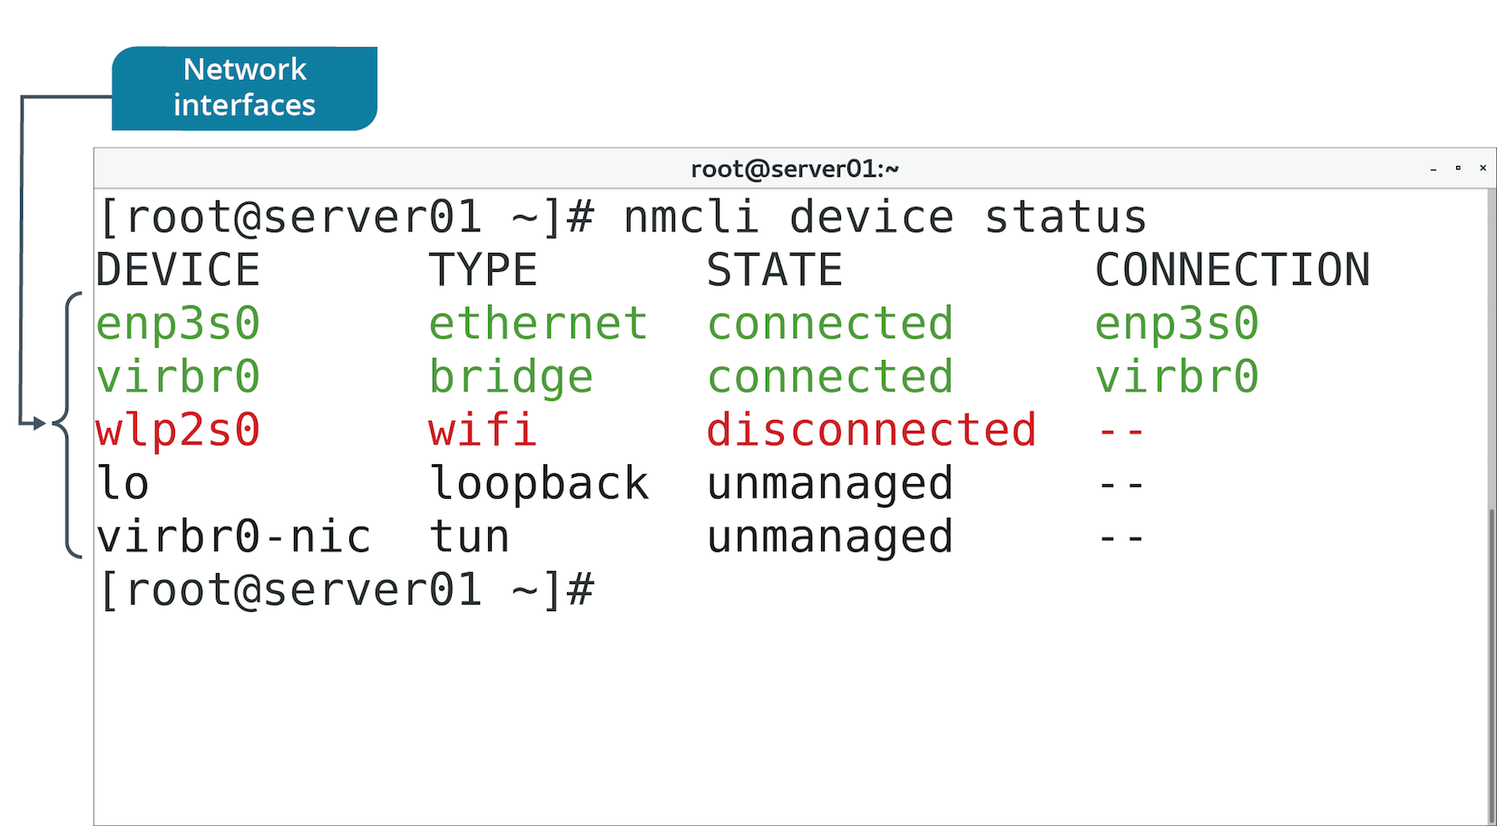
The nmcli Command (Slide 1 of 2)
Most fundamental NetworkManager interface.
Includes subcommands for configuring network info.

Slide 42
The nmcli Command (Slide 2 of 2)
Subcommand | Used To
general status | View summary of network connectivity.
connection show | View identification info for each NIC.
con up {device ID} | Enable specified NIC.
con down {device ID} | Disable specified NIC.
con edit {device ID} | Enter interactive mode to configure specified NIC.
device status | Display current status of each NIC.

Slide 43
The nmtui Utility (Slide 1 of 2)
Another NetworkManager interface.
Calls up text-based user interface.
More visual than CLI, not quite as visual as GUI.
Navigation:
Tab key to move from field to field.
Arrow keys to make selections within field.
Enter key to activate a field.
Spacebar to check/uncheck check box.

Slide 44
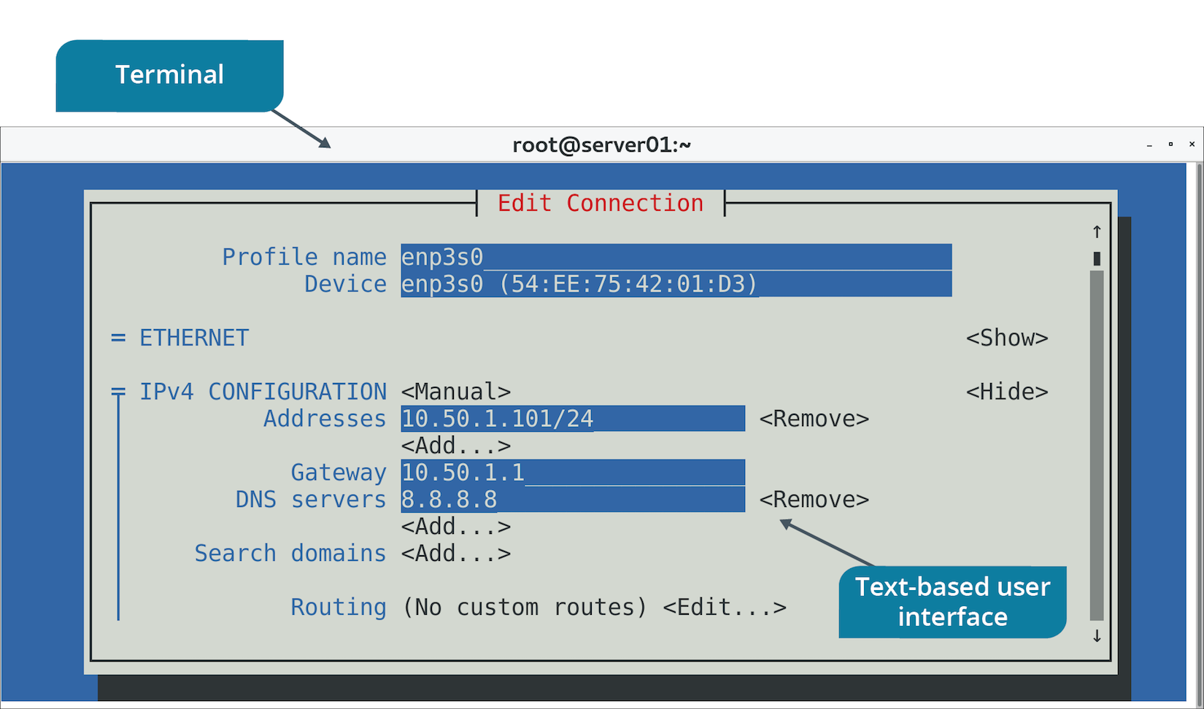
The nmtui Utility (Slide 2 of 2)

Slide 45
The nmgui Utility (Slide 1 of 2)
GUI tool.
Useful for managing workstations.
Enables configuration of many settings.
Will look familiar to end-users.

Slide 46
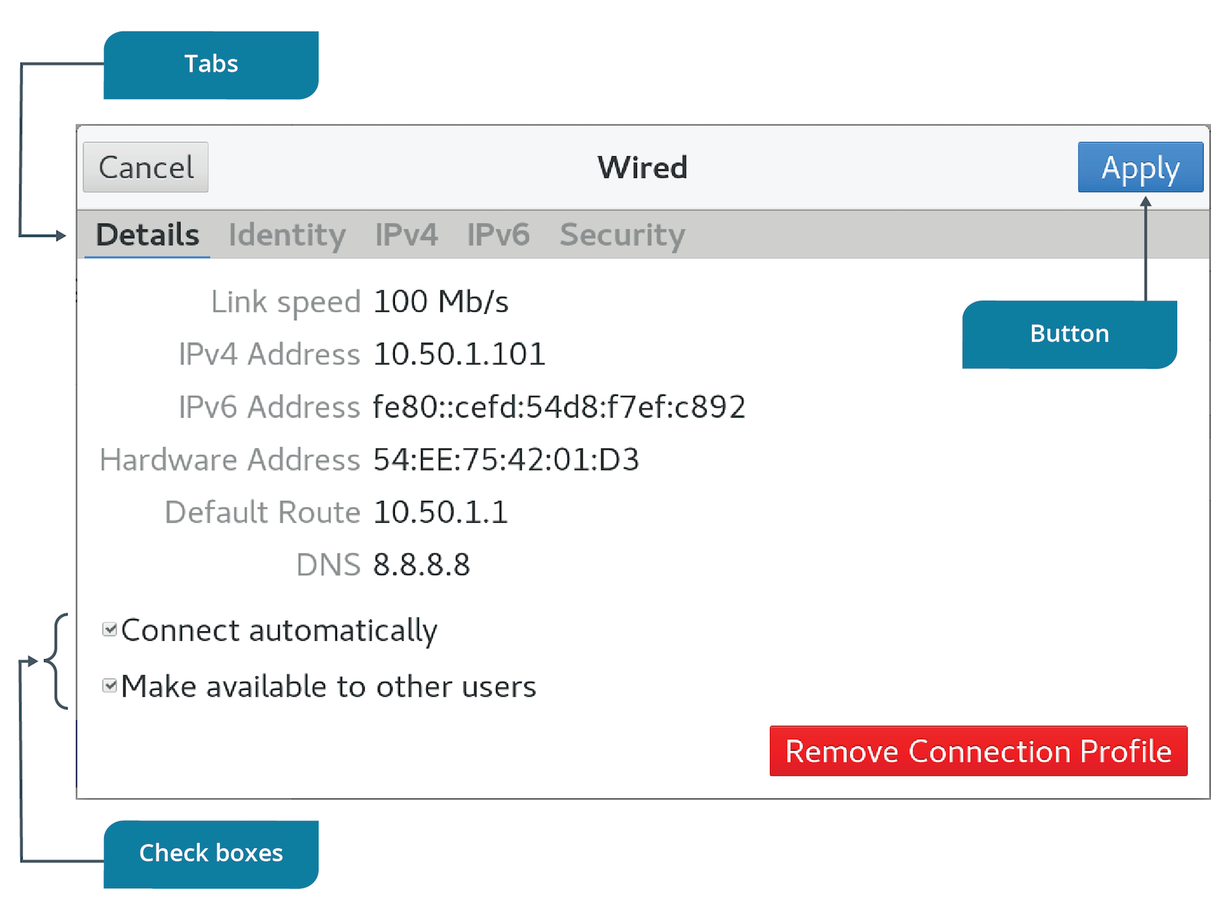
The nmgui Utility (Slide 2 of 2)

Slide 47
The ifconfig Command
Enables user to view current IP addressing info for each NIC.
Early step in troubleshooting.
Shows:
IP address
Subnet mask
Broadcast ID
MAC address
Performance info
NIC name
Officially deprecated in Linux, but still available in some distros.

Slide 48
The ip Command (Slides 1 of 2)
Replaces ifconfig
Produces similar info.
Examples:
ip addr show
ip link
ip link set eth1 up
ip link set eth1 down

Slide 49
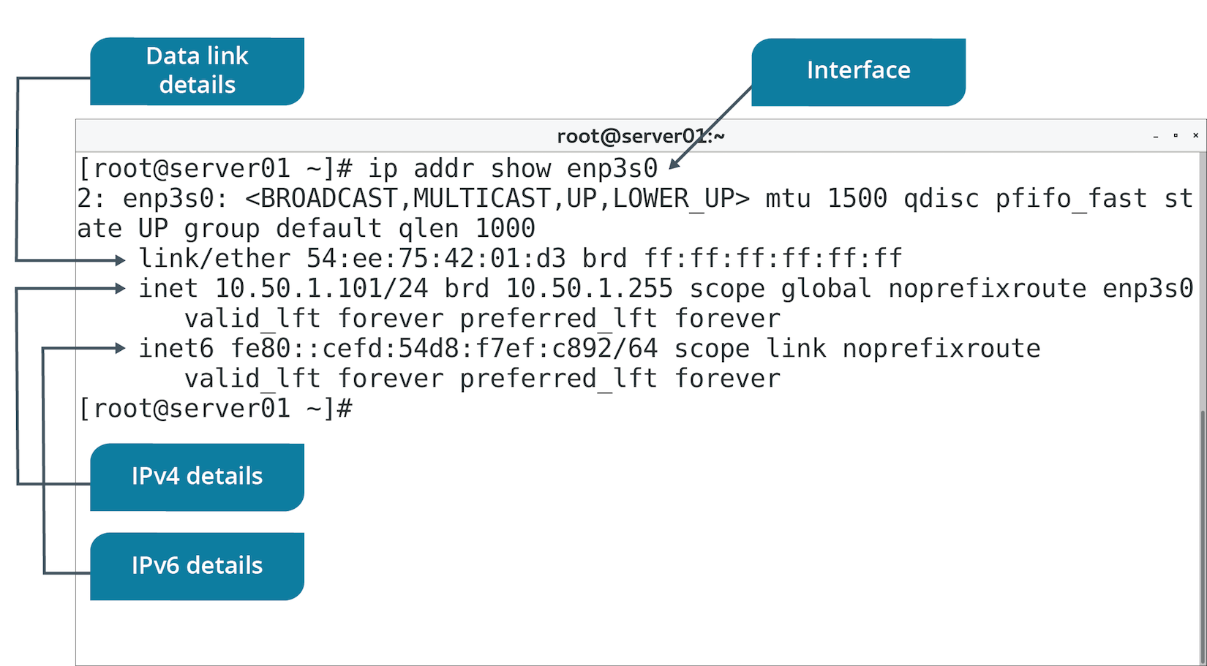
The ip Command (Slides 2 of 2)

Slide 50
The iwconfig Command
Provides wireless NIC configurations.
Settings like SSID, encryption info, etc.

Slide 51
Activity: Configuring the Server's Network Identity
You need to ensure hostname and IP address are correct.
You also need to configure network settings with or without a GUI.
You'll configure both static and dynamic addresses.

Slide 52
The ethtool Command (Slide 1 of 2)
Manages NIC driver and network configs.
Appears on some distros.
Has many options for info gathering.

Slide 53
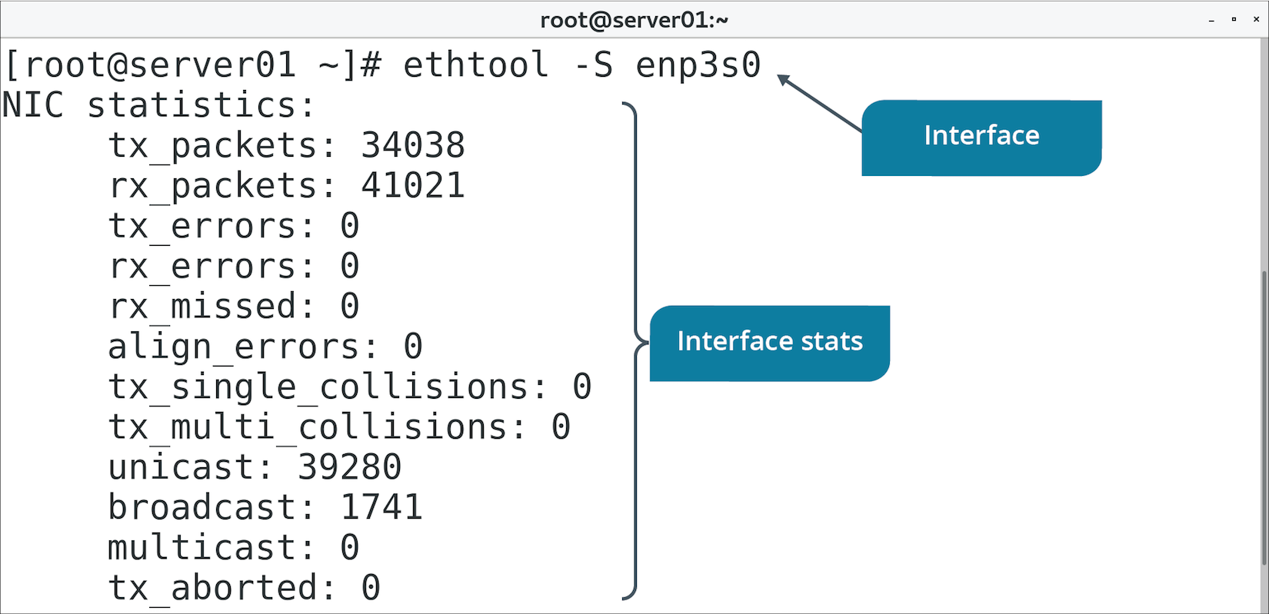
The ethtool Command (Slide 2 of 2)

Slide 54
The brctl Command
Configures network bridging.
Associating two networks together.
Works at Layer 2 with MAC addresses.
Example process:
brctl show
brctl addbr {bridge name}
brctl addif {bridge name} eth0
brctl addif {bridge name} eth1

Slide 55
NIC Bonding (Slide 1 of 2)
The technique of associating two network interfaces together so that they are managed as a single device.
Aggregates bandwidth
Provides fault tolerance/redundancy.
If one NIC fails, other still provides connectivity.
Provides load balancing.
Prevents one NIC from being overwhelmed.
Active/passive setup:
System fails over to second NIC if first NIC fails.
Supported in Linux.
Switch must support EtherChannel.

Slide 56
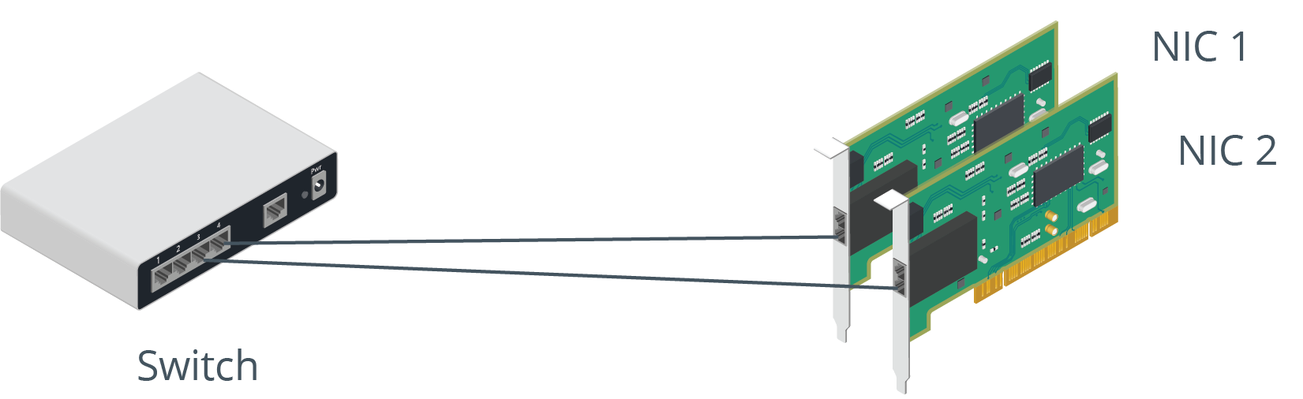
NIC Bonding (Slide 2 of 2)

Slide 57
The /etc/sysconfig/network-scripts/ Directory (Slide 1 of 2)
Contains device configuration files.
NICs, bonds, bridges, etc.
Take form of ifcfg-<NIC>
Used to set NIC as enabled.
Used to set NIC as having a static or dynamic IP address.
Settings vary depending on device type.
Use NetworkManager to edit these scripts rather than a text editor.

Slide 58
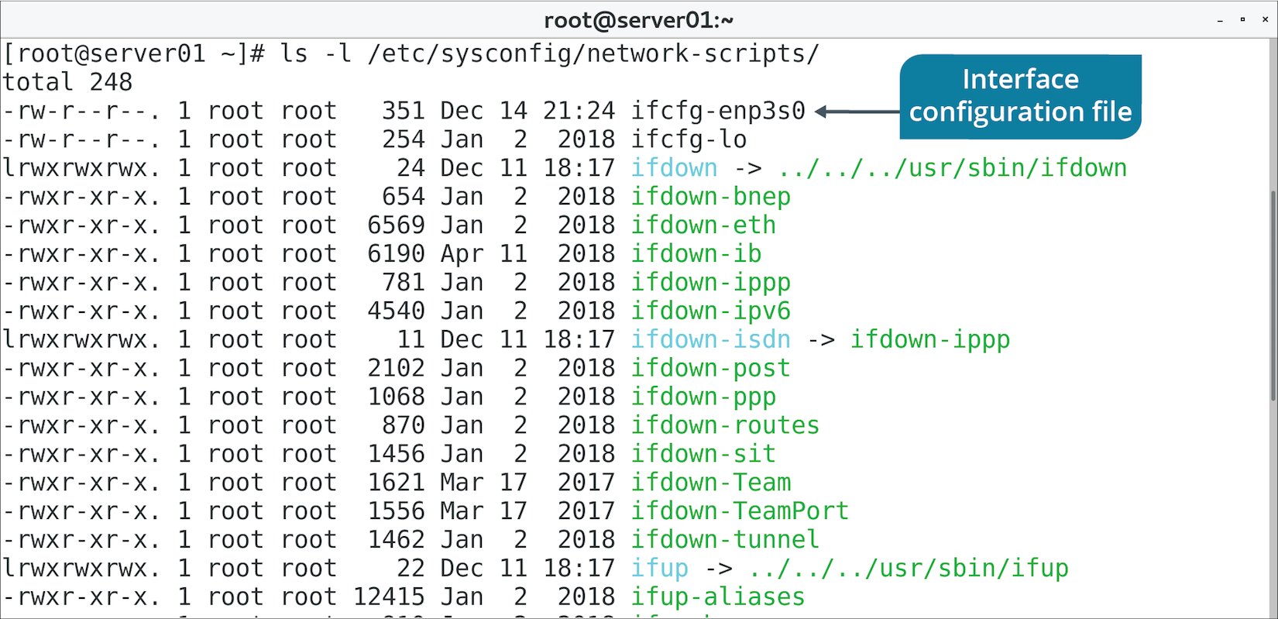
The /etc/sysconfig/network-scripts/ Directory (Slide 2 of 2)

Slide 59
The /etc/sysconfig/network File
Configures whether network should be enabled at boot.
Configures hostname, gateway, etc.
Can be configured per-NIC in scripts mentioned previously.
Mostly found on Red Hat-based distros.
/etc/sysconfig/interfaces is found on Debian derivatives.

Slide 60
Discussing Connecting to a Network

Slide 61
Activity: Verifying Network Configurations
You need to verify your earlier config is accurate.
You'll use ethtool and device's config file to confirm details.

Slide 62
Static vs. Dynamic IP Address Configuration
Static:
Increases risk of mistakes.
Increases admin workload.
Ensures system has same identity.
IP address never changes.
Appropriate for network devices and servers.
Dynamic:
Decreases risk of mistakes.
Decreases admin workload.
Doesn't ensure a consistent identity.
IP address can change.
Appropriate for client machines.

Slide 63
DHCP Configuration
DHCP server contains pools of IP address and related config info.
Clients lease from pool.
Saves on admin effort; no need to configure clients manually.
Servers configured with a scope of IP addresses.
Service must allow client machines to lease configurations.

Slide 64
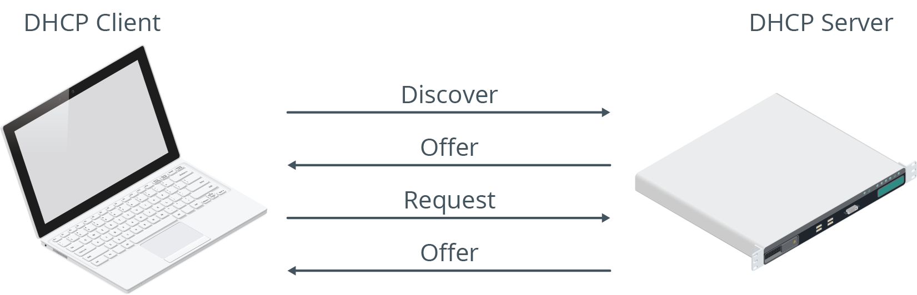
The DHCP Lease Generation and Renewal Process
Lease process initiated by clients.
Leases are temporary and need to be renewed periodically.
Leases include IP address, subnet mask, etc.
DHCP server may force client to renew lease.

Slide 65
The /etc/dhcp/dhclient.conf File
Primary DHCP client reference file.
Configures timeout values, dynamic DNS, etc.
Managed by NetworkManager.
Usually better to configure DHCP through NetworkManager.
Rather than editing file directly.

Slide 66
Name Resolution (Slide 1 of 2)
Humans have a difficult time remembering IP addresses.
Work with easy-to-remember names instead.
These names aren't useful to a computer.
Name resolution translates hostnames to IP addresses.
Can be done through static text files.
Can be done through a dynamic DNS server.

Slide 67
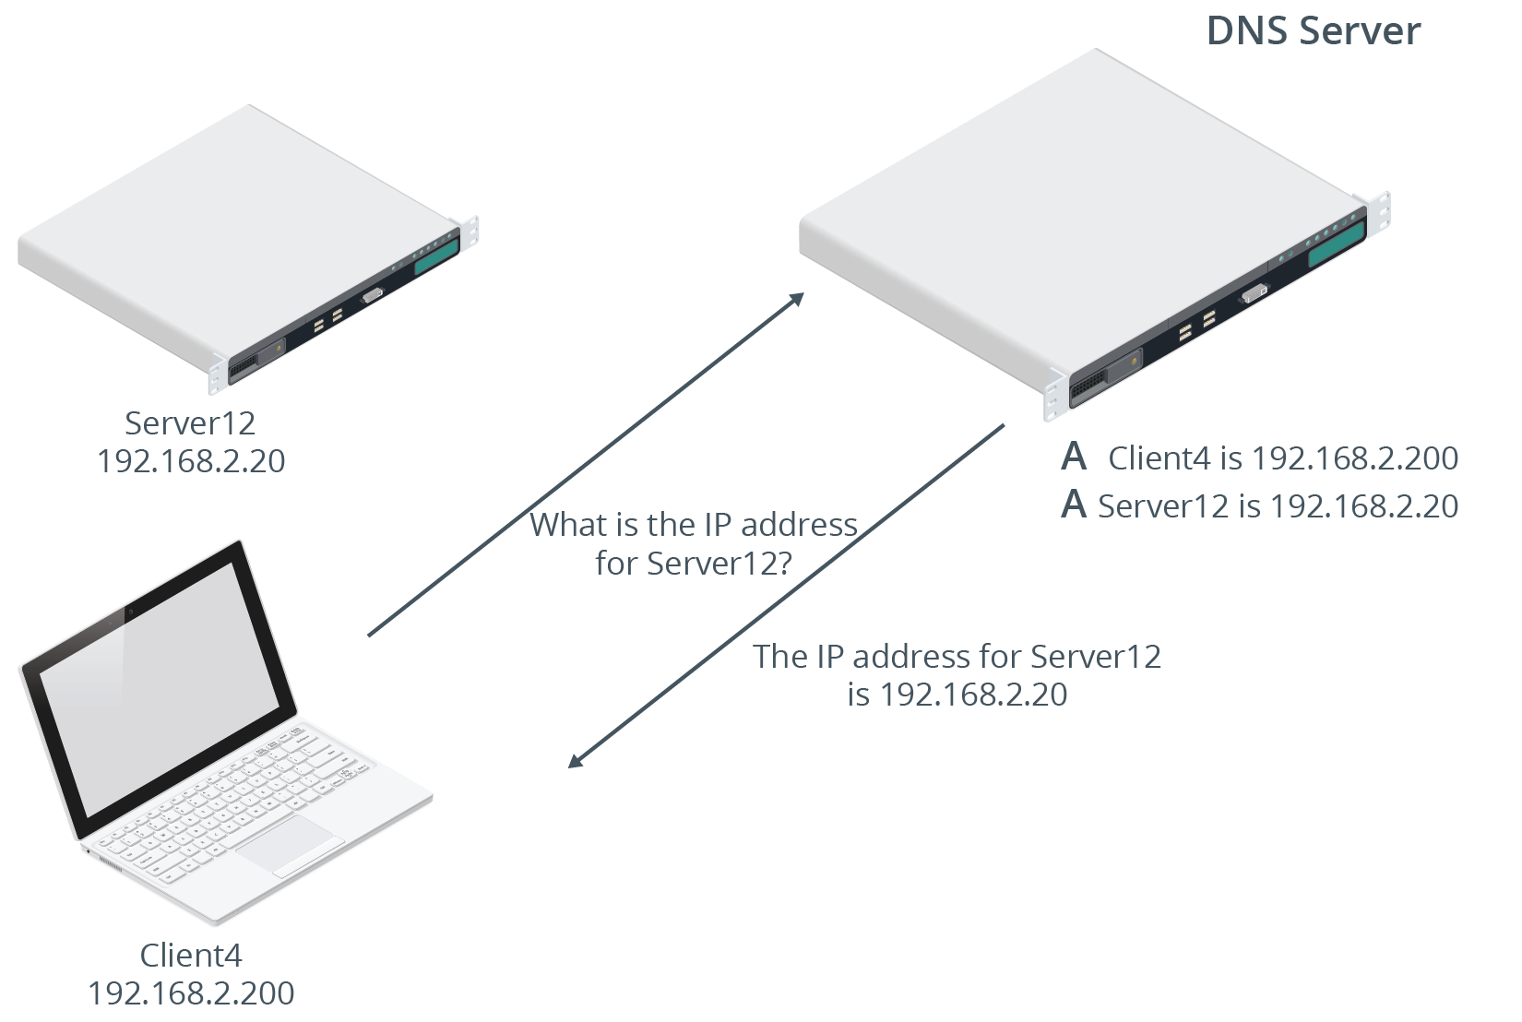
Name Resolution (Slide 2 of 2)

Slide 68
The /etc/hosts File (Slide 1 of 2)
Name resolution handled by a text file.
Lists hostnames mapped to IP addresses.
Needs to be manually updated if changes.
Not realistic in modern environments.
Can still be used in special cases.
Example: Developer system needs to connect to test server that isn't registered.

Slide 69
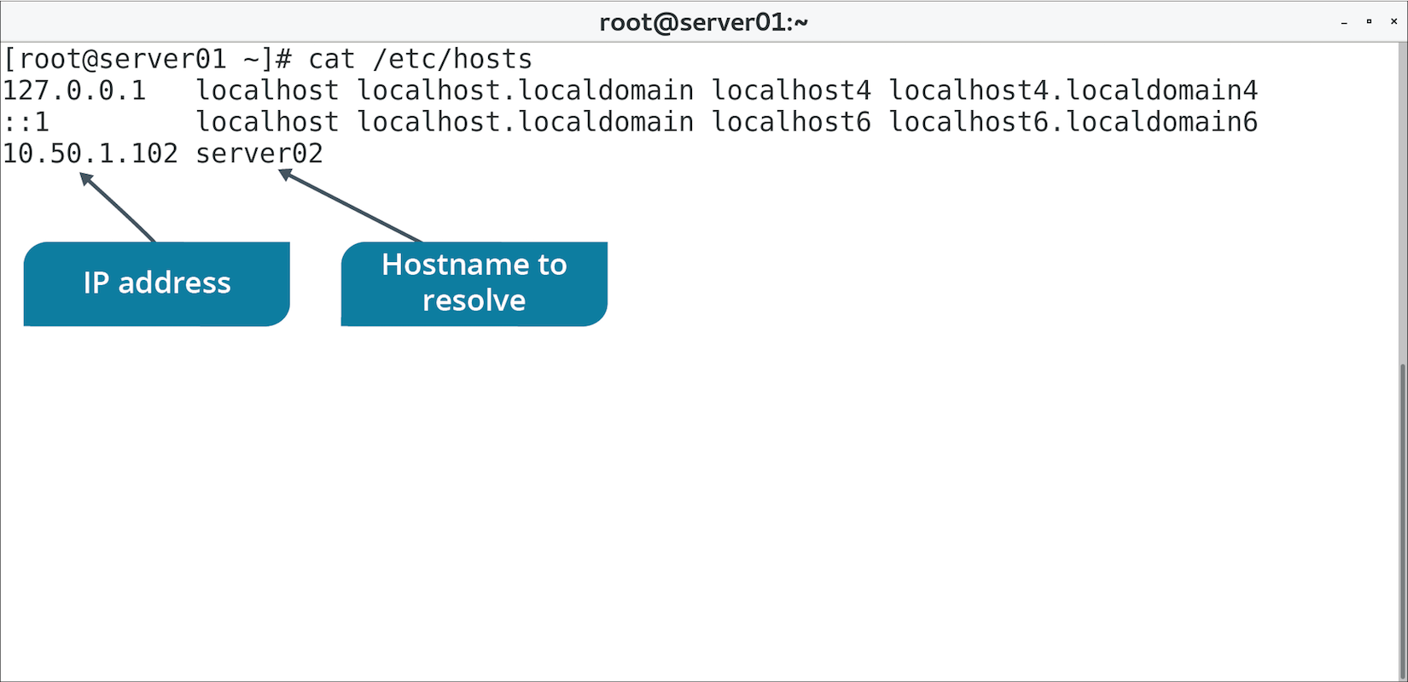
The /etc/hosts File (Slide 2 of 2)

Slide 70
The /etc/resolv.conf File (Slide 1 of 2)
DNS servers are easier to maintain than /etc/hosts file.
/etc/resolv.conf specifies IP addresses of DNS servers.
Good practice to have at least two DNS servers specified.

Slide 71
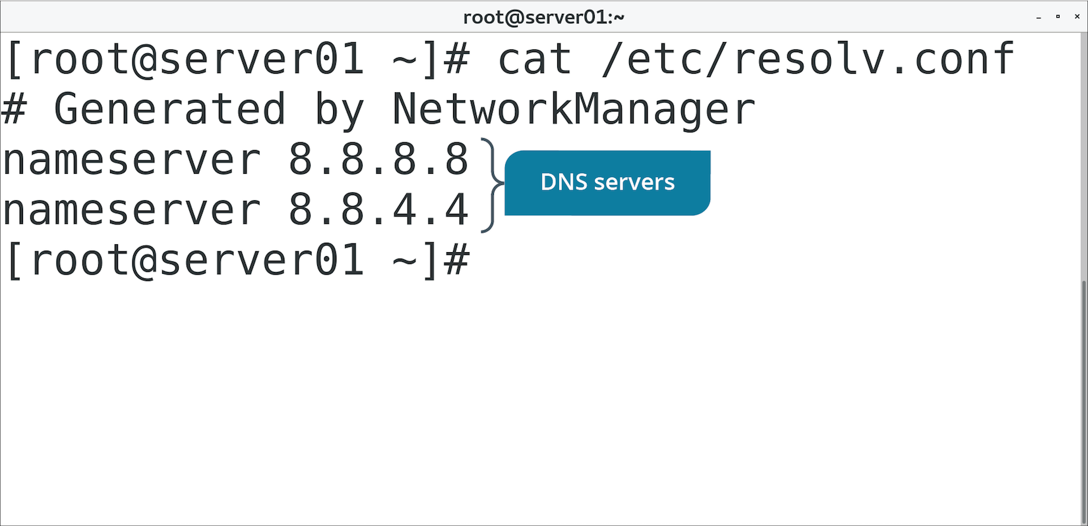
The /etc/resolv.conf File (Slide 2 of 2)

Slide 72
The /etc/nsswitch.conf Files (Slide 1 of 2)
Includes several config options for name resolution.
Defines order of name resolution options.
Preferred order:
/etc/hosts
DNS servers

Slide 73
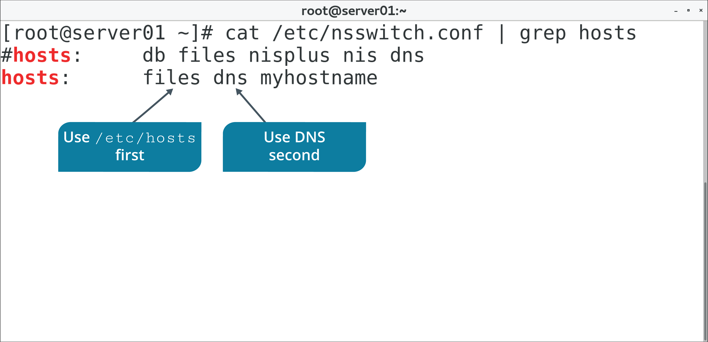
The /etc/nsswitch.conf Files (Slide 2 of 2)

Slide 74
DNS Configuration Using NetworkManager
Includes CLI, text-based, and GUI interface utilities.
Use utilities to configure IP address of at least one DNS server.

Slide 75
Discussing DHCP and DNS Client Services

Slide 76
Activity: Configuring a DNS Client
You need to account for human-friendly hostnames.
You'll configure name resolution to relate a hostname to an IP address.
Users can more easily refer to a specific computer on the network.

Slide 77
Cloud Computing
The practice of delivering on-demand resources to clients over a distributed network like the Internet.
Characteristics:
On-demand self-service
Broad network access
Resource pooling
Rapid elasticity
Measured service
Has become mission-critical for many organizations.
Off-loads responsibility onto third party.
Cost, ownership, maintenance, etc.
Flexible, scalable, and supports fault tolerance.

Slide 78
Cloud Models
Model | Description
SaaS | Provides apps to end-users. Apps seem local, but are in the cloud. Deployment, maintenance, and upgrades are off-loaded.
PaaS | Virtualizes operating systems to provide to customer. Platform support is off-loaded. Targets developers and database admins.
IaaS | Virtualizes physical devices owned by provider. Hardware lifecycle responsibility is off-loaded. Targets system admins.

Slide 79
Cloud Service Providers
AWS and Microsoft Azure are the primary CSPs.
AWS is built on Linux.
Azure also supports Linux-based deployments.
Red Hat Cloud Suite is a private cloud solution.
Additional CSPs:
Google Cloud
Rackspace
Heroku
Digital Ocean

Slide 80
Cloud and Virtualization
Virtualization enables:
More efficient use of hardware.
Fault tolerance, recovery, and scalability.
Quicker deployment of services.
Virtualization is the foundation of cloud computing.
Cloud providers virtualize resources they offer to customers.
Extends to all models.
Example: Admin easily builds a cluster of systems in a single action.
Can easily tear it down when necessary.
Process can be automated.
More efficient than if using physical systems.

Slide 81
Hypervisors
A layer of software that separates a VM's software from the physical hardware it runs on.
Manages hardware allocation, networking, administration, etc.
Type 1 runs on "bare metal" of system.
VMware ESXi, Microsoft Hyper-V, etc.
Type 2 runs as a service on OS.
Oracle VM VirtualBox, QEMU, etc.
KVM is a Linux-based hypervisor.
Manages VMs with type 1 and type 2 attributes.

Slide 82
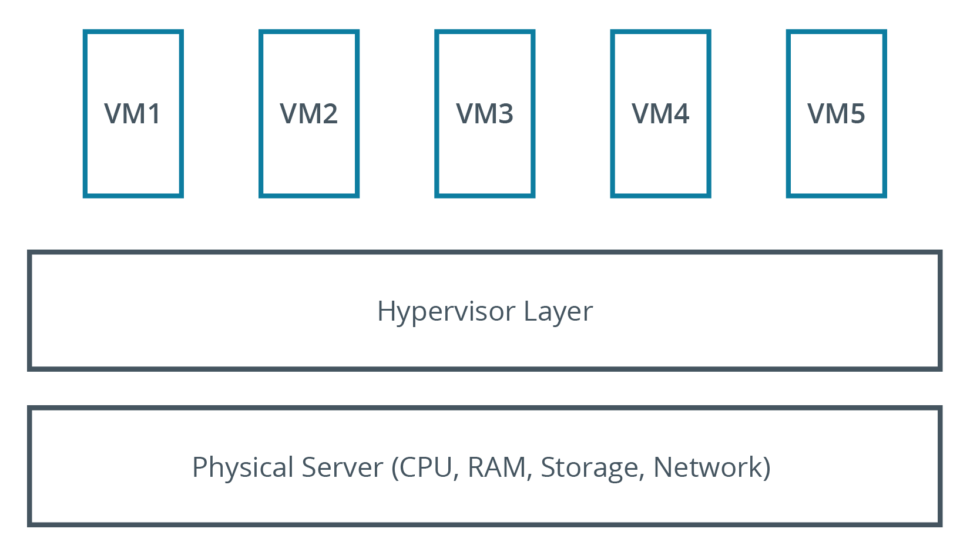
Type 1 Hypervisor

Slide 83
Templates
Template | Description
OVF | Contains config files, packages, etc. for VMs and network devices. OVA is a single package for a network appliance.
JSON | Easily interpreted by programming languages. Easy for humans to write and read. Used in quick deployment/config of VMs.
YAML | Stores config info used to deploy VMs. Can install software/create user accounts on first boot. Consists of key–value pairs.
Container images | Provides app isolation, different than VMs. Used for testing apps. Images contain everything needed to run container.

Slide 84
Bootstrapping
OS starts with simple layers and moves toward the complex.
VM bootstrapping is handled by virtualization layer.
You can modify deployment of VMs during bootstrapping.
Cloud-init customizes VMs during first boot.
Security settings, software, users/groups, etc.
References YAML files.
Supported by many Linux distros.
Anaconda installer configures new Linux systems.
References Kickstart files to customize install.
Installation procedures are specified in Kickstart file.
Enables rapid, consistent installation.

Slide 85
Storage
Storage exposed to VMs as virtual devices.
Files that reside on physical drive.
Treated as if it were a physical drive.
Partitioned, formatted, etc.
Virtual files provide:
Fault tolerance.
Rolling back system.
Redundancy.
Storage scalability.

Slide 86
Blob and Block Storage
Blobs store data in unstructured manner.
Binary large object.
Audio, video, text, and more types of files.
Example of object storage.
Data is written to storage device in chunks called blocks.
Files may be too large to store on one block.
Files are broken into pieces, then written as blocks.
Data is reassembled by OS.
Object storage can be more efficient for larger files.
Object storage can be more flexible when storing data in multiple regions.

Slide 87
Networking Configurations
VM can be configured with one or more NICs.
NICs can be connected to virtual switches.
Config options:
No networking
Internal
Private
Public
Manage network configs for VMs carefully.
VMs need to be protected like actual machines.
Follow security best practices for networked VMs.

Slide 88
Virtualization Tools
virsh is interactive shell to KVM virtual machines.
Subcommand | Used To
help | Get help with virsh command.
list | Get list of recognized VMs.
shutdown {VM} | Gracefully shut down VM.
start {VM} | Start VM.
reboot {VM} | Reboot VM.
create {XML file name} | Create VM from XML file.
save {VM} {file name} | Save state of VM.
console {VM} | Open console to VM.

Slide 89
Discussing Cloud and Virtualization Technologies

Slide 90
Activity: Configuring Virtualization
A developer wants a test environment for a new app.
She wants to be able to revert environment for each test.
You'll install a KVM solution for her.

Slide 91
Common Networking Issues
Check the basics:
Is the device powered, plugged in?
Is NIC "down"?
Is interface configured correctly?
Gather driver info about NIC using ethtool command.
Troubleshoot name resolution:
Ping by both hostname and IP address.
If IP address succeeds but hostname doesn't, there is a problem with name resolution.
Use tools like nslookup to test name resolution.
Troubleshoot network itself:
Latency, saturation, dropped packets, timeouts, etc.
Router may be misconfigured.
Escalate to network team.

Slide 92
The ping Command
Used to send test packets between systems on a network.
Sending computer looks for a reply from destination computer.
Outcomes:
Reply from <host>
Destination unreachable
Timeout

Slide 93
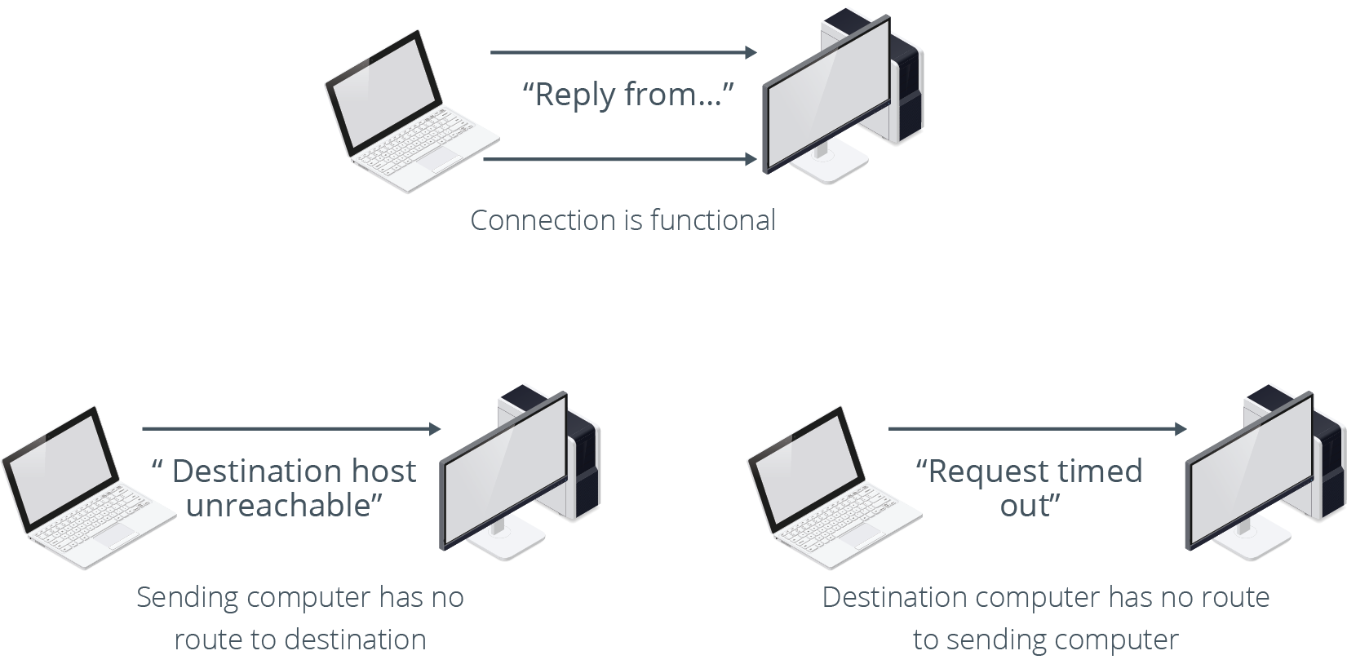
Pinging Results

Slide 94
The traceroute and tracepath Commands (Slide 1 of 2)
traceroute is used to report network path between computers.
Includes routers along the way.
Used for troubleshooting connectivity.
Can identify where connection failed.
tracepath is a simplified version.
No root privileges necessary.
Fewer options.

Slide 95
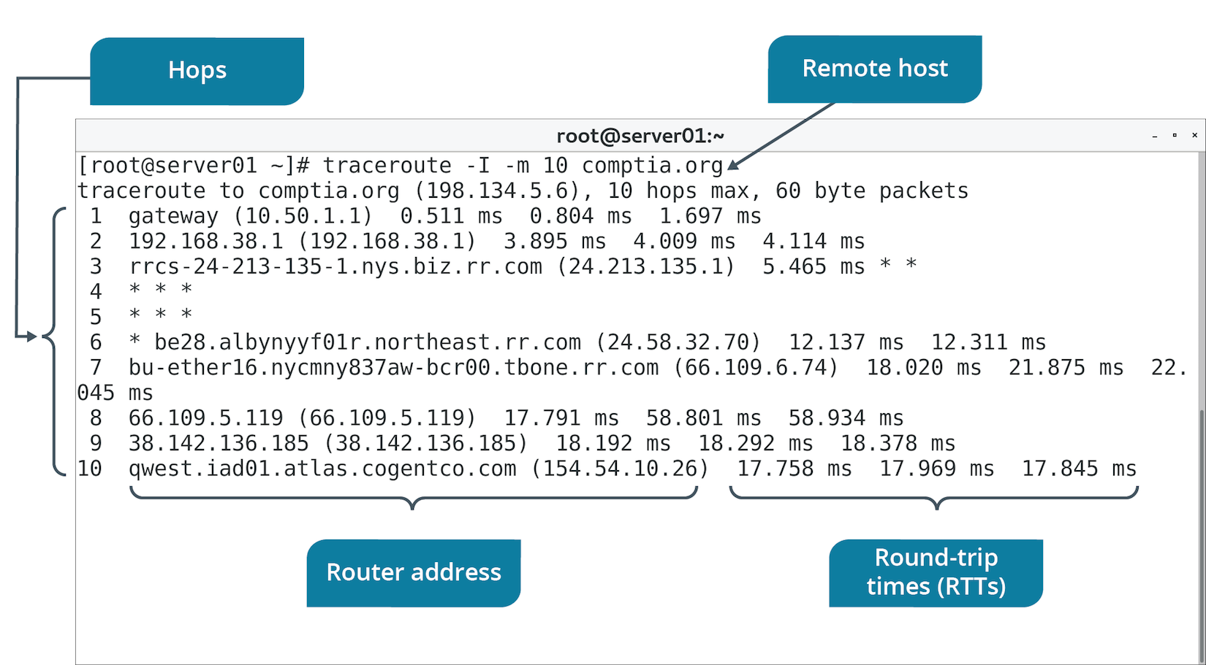
The traceroute and tracepath Commands (Slide 2 of 2)

Slide 96
The netstat Command
Gathers info about TCP connections on system.
Existing connections, listening ports, NIC info, etc.
Deprecated in favor of ss command.
Option | Used To
-v | Activate verbose mode.
-i [interface] | Display info about all network interfaces or interface specified.
-c | Continuously print info every second.
-l | Show only what ports are being listened on.

Slide 97
The ss Command (Slides 1 of 2)
Similar to netstat but with simpler output/syntax.
Can gather info on TCP connections.
Can gather info on clients that are connected.
Option | Used To
-l | Show currently listening sockets.
dst {host} | Show whether host is connected and its stats.
-i | Show only what ports are being listened on.

Slide 98
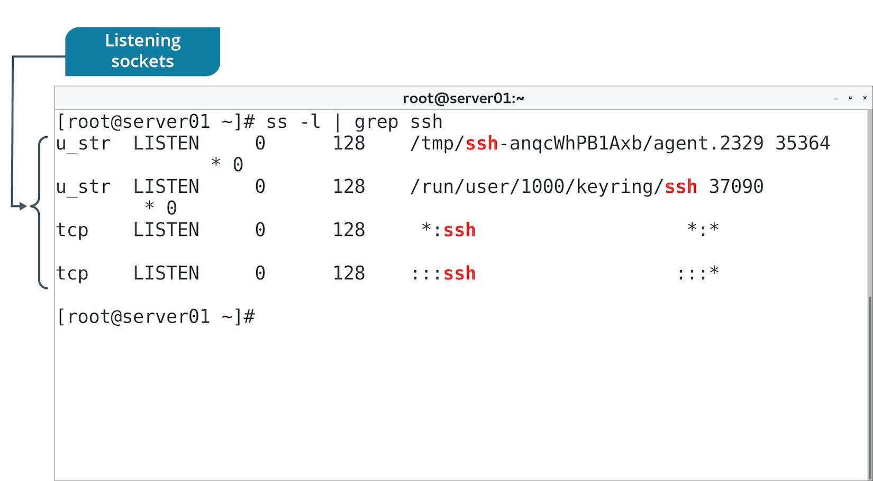
The ss Command (Slides 2 of 2)

Slide 99
The dig, nslookup, and host Commands
All used to test name resolution.
Command | Description
dig | Outputs IP address mapped to domain, answering DNS server, and time taken to receive answer. Example: dig @{IP address} {domain name}
nslookup | Has interactive and non-interactive mode. Example: nslookup {domain name}
host | Simple tool. Example: host {domain name} {IP address}

Slide 100
The ip Command for Troubleshooting
Use ip addr to verify network configuration is accurate.
Link-local address indicates misconfiguration.
Check NIC's status as either up or down.
Use -s option to view connection usage stats.

Slide 101
The route Command (Slide 1 of 2)
Linux can be configured as a router.
Includes routing table entries.
route command displays and manages routing table.
Command | Used To
route | View current routing table.
route add default gw {IP address} | Configure default gateway by IP address.
route add –host {IP address} reject | Filter traffic based on specified IP address.

Slide 102
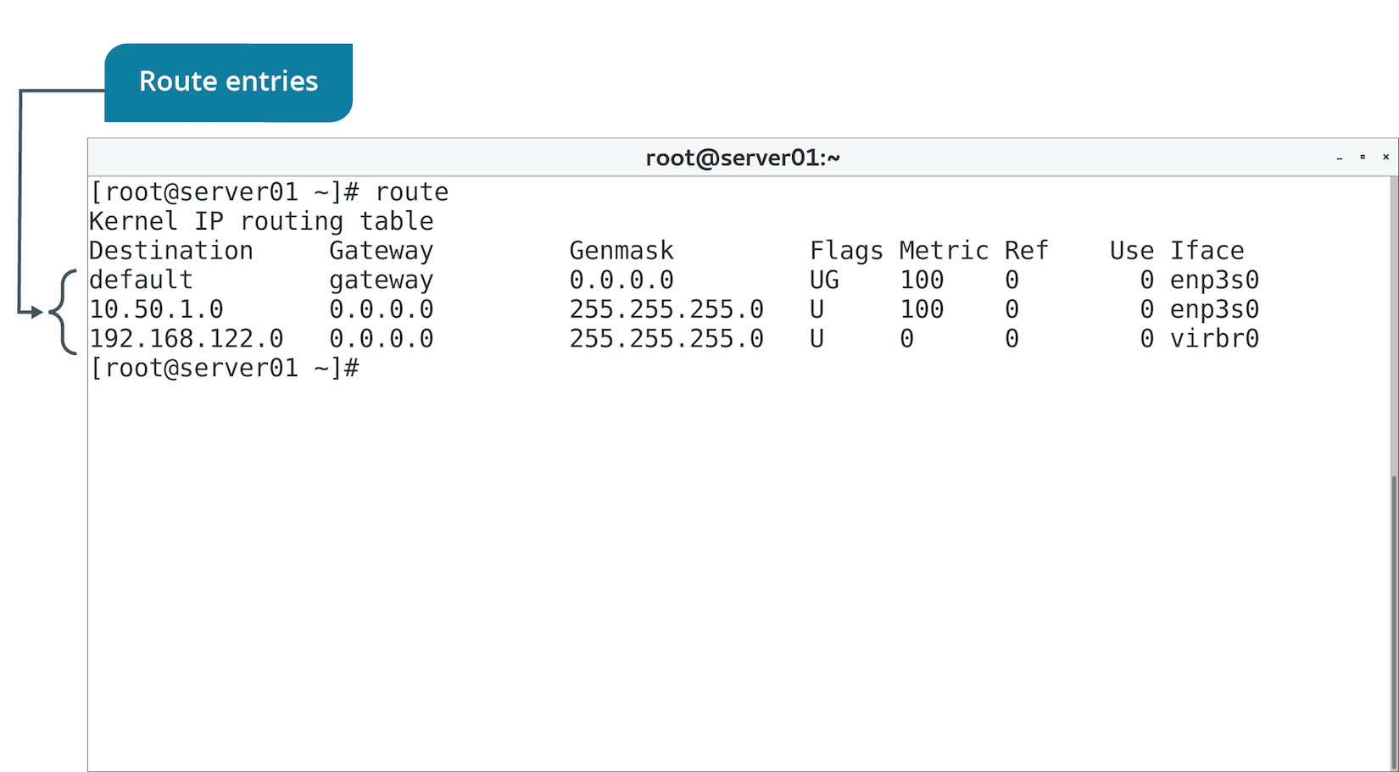
The route Command (Slide 2 of 2)

Slide 103
The nmap Command (Slide 1 of 2)
Maps a network environment.
Identifies nodes and reports OS, service info, addresses, and much more.
Has many options.
GUI version called Zenmap.
Can audit/document network.
Vital in troubleshooting.
Troubleshooting example:
ip addr
ping {destination}
nmap

Slide 104
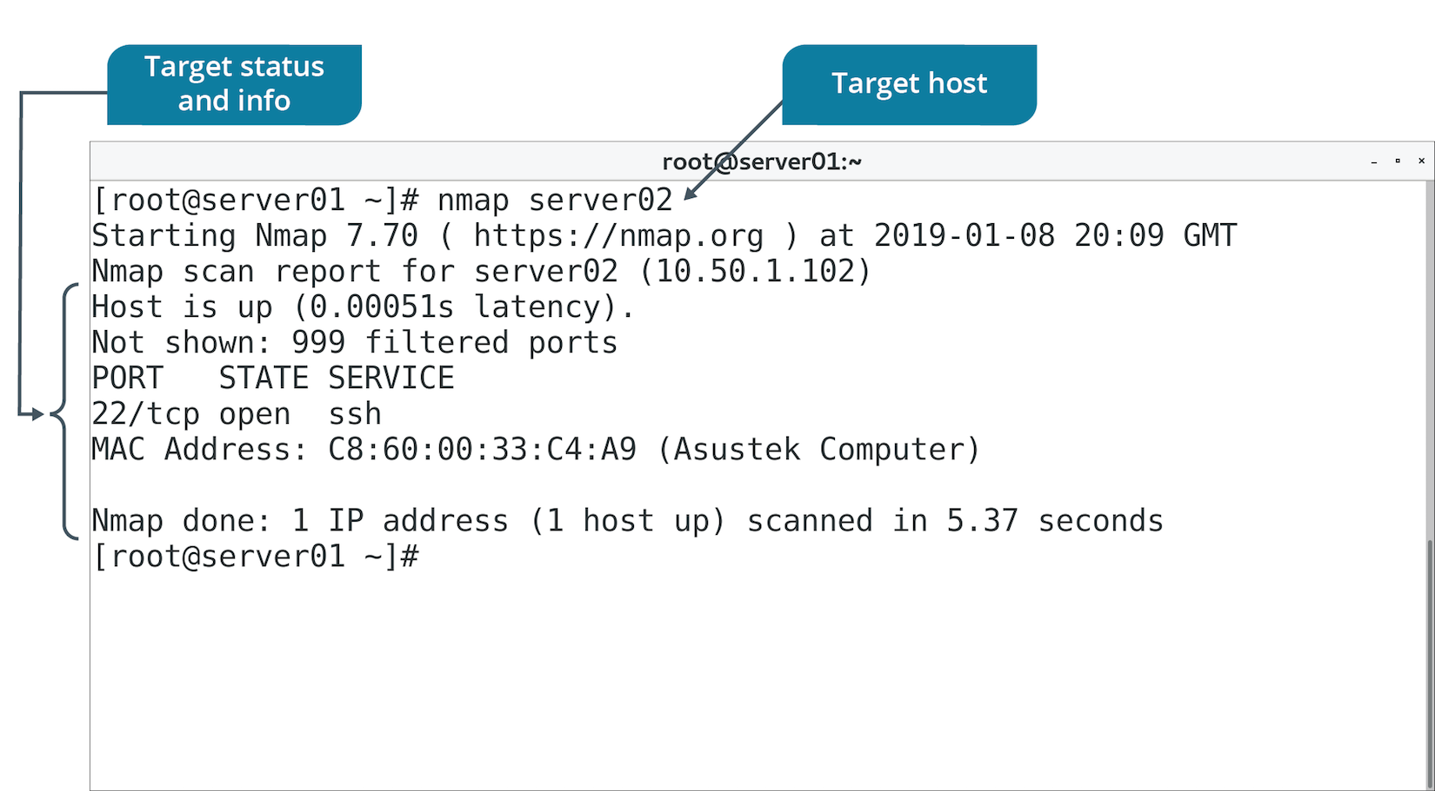
The nmap Command (Slide 2 of 2)

Slide 105
Wireshark (Slide 1 of 2)
A common network packet sniffer and analysis tool.
Can intercept and potentially read network traffic.
Info includes source/destination addresses, port numbers, payload, etc.
Can show what packets are/are not moving through a segment or NIC.
Troubleshooting example:
ip addr
ping {destination}
firewall-cmd --list-services
Wireshark

Slide 106
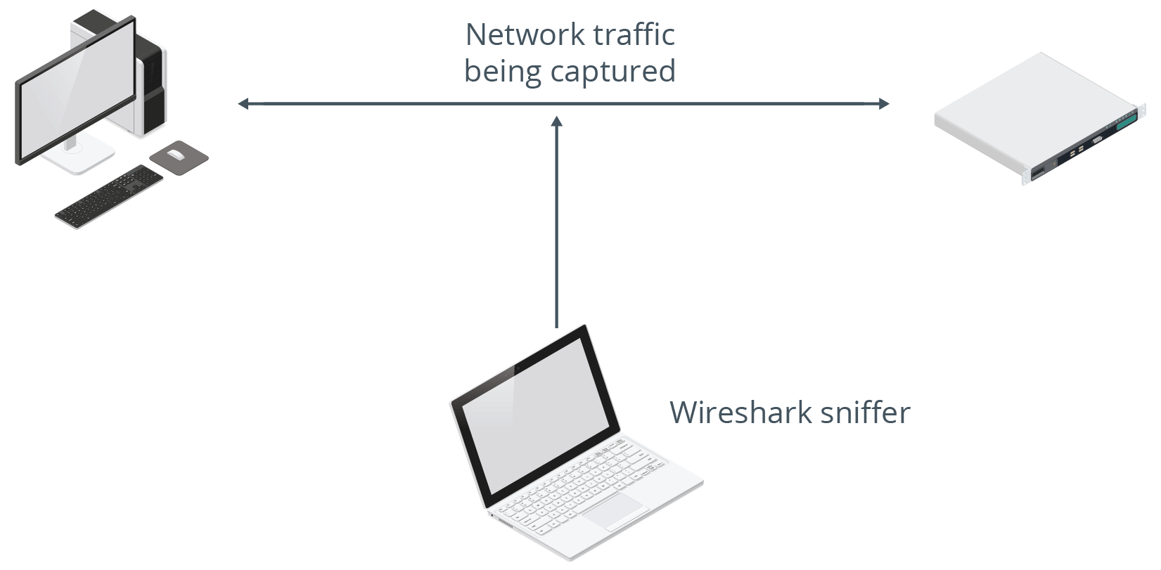
Wireshark (Slide 2 of 2)

Slide 107
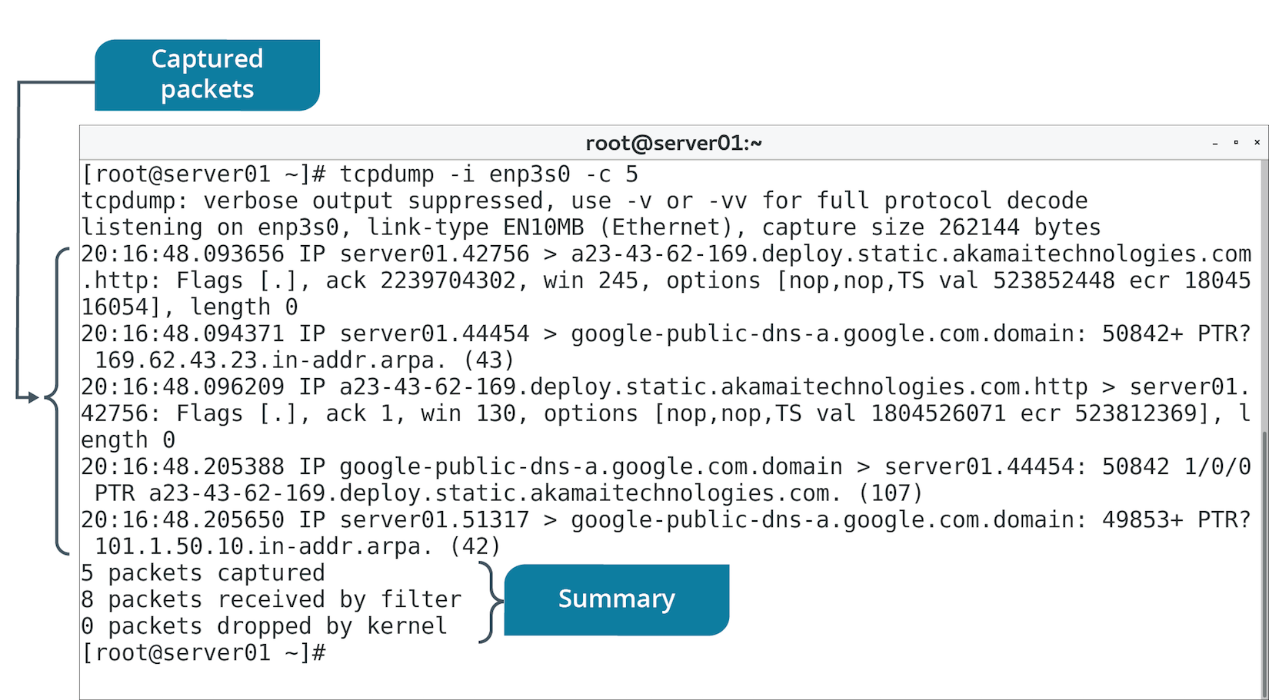
The tcpdump Command (Slide 1 of 2)
Similar to Wireshark, but in CLI form.
Installed on most distros.

Slide 108
The tcpdump Command (Slide 2 of 2)
Option | Used To
-i | Specify interface to use.
-n | Not resolve hostnames.
-v | Specify verbose mode.

Slide 109
The netcat Command
Can test connectivity over a network.
Can listen on a destination computer and attempt to connect to source.
Use Case | Command Example
Connect two computers to transfer data | On comp1 (listen on port): netcat -l 4242 On comp2 (connect to listener): netcat comp1 4242
Transfer files between two computers | On comp1 (listen on port): netcat -l 4242 > received.file On comp2 (connect to listener): netcat comp1 < original.file
Port scan a computer | netcat -z -v domain.tld 1-1000

Slide 110
The iftop Command (Slide 1 of 2)
Displays bandwidth usage.
Can reveal NIC/protocol consuming most bandwidth.
Use to identify why a link may be slow.
Example: iftop -i eth0
Network slowness may be symptom of bandwidth saturation.
Bandwidth capacity is being used up.
Use iftop to identify excessive incoming/outgoing traffic on a NIC.
Use to identify offending host(s).
Take steps to stop offending host(s) from saturating network.

Slide 111
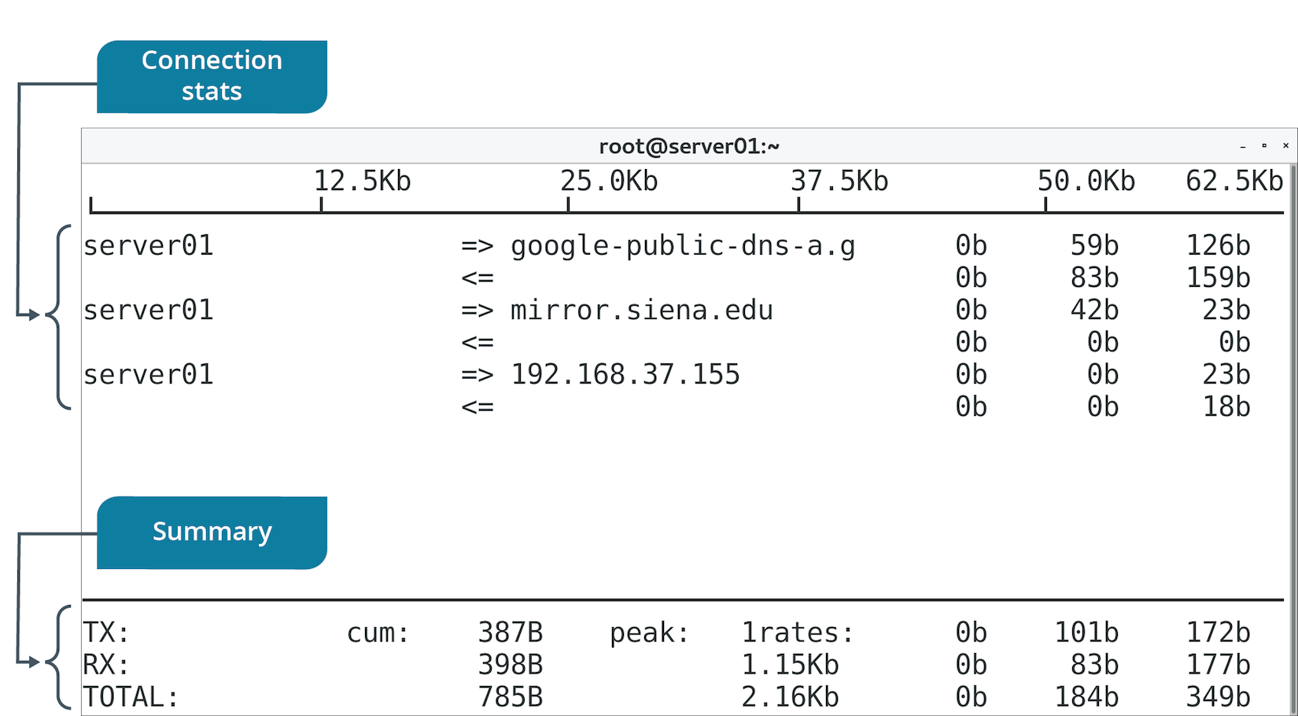
The iftop Command (Slide 2 of 2)

Slide 112
The iperf Command (Slide 1 of 2)
Tests max throughput for an interface.
Installed on two endpoint systems.
One is server, the other client.
Client is being tested.
Use to ensure throughput is meeting expectations.
Basic test:
On server, run iperf -s
On client, run iperf -c {server address}
Examine results.

Slide 113
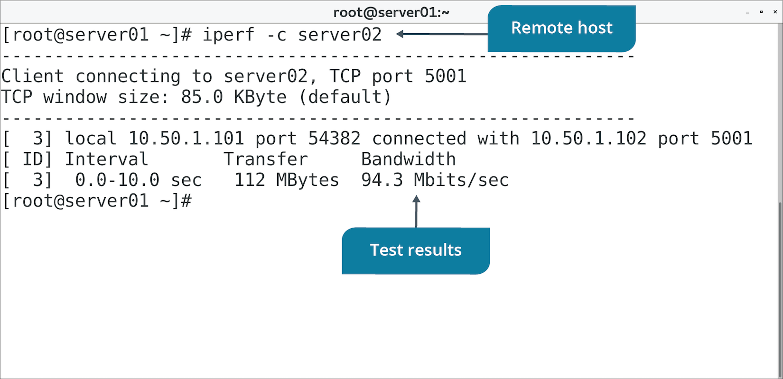
The iperf Command (Slide 2 of 2)

Slide 114
The mtr Command (Slide 1 of 2)
Combines ping, traceroute, and more for testing connection quality.
Packets sent to destination in large groups.
Time taken for response is noted.
Takes note of lost/dropped packets.
Packets can't reach destination.
Can lead to latency or lost data.
Many lost packets indicate an issue on the path.
mtr outputs percentage of packets lost.
High percentage on a node may suggest it is faulty.

Slide 115
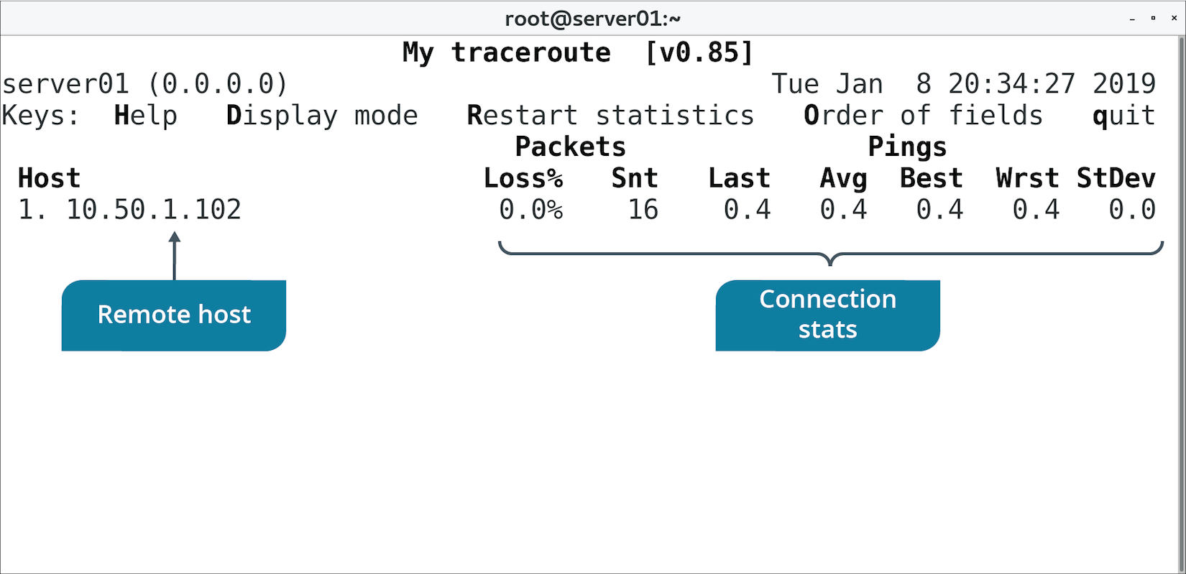
The mtr Command (Slide 2 of 2)

Slide 116
The arp Command (Slide 1 of 2)
ARP relates IP addresses and MAC addresses.
arp command discovers info about known MAC addresses.
Computers cache resolved IP/MAC address combinations.
Incorrect or out-of-date info can lead to lost connectivity.
ARP cache can be cleared to troubleshoot.
arp -d {IP address} to clear entry.
arp -a to view cache.

Slide 117
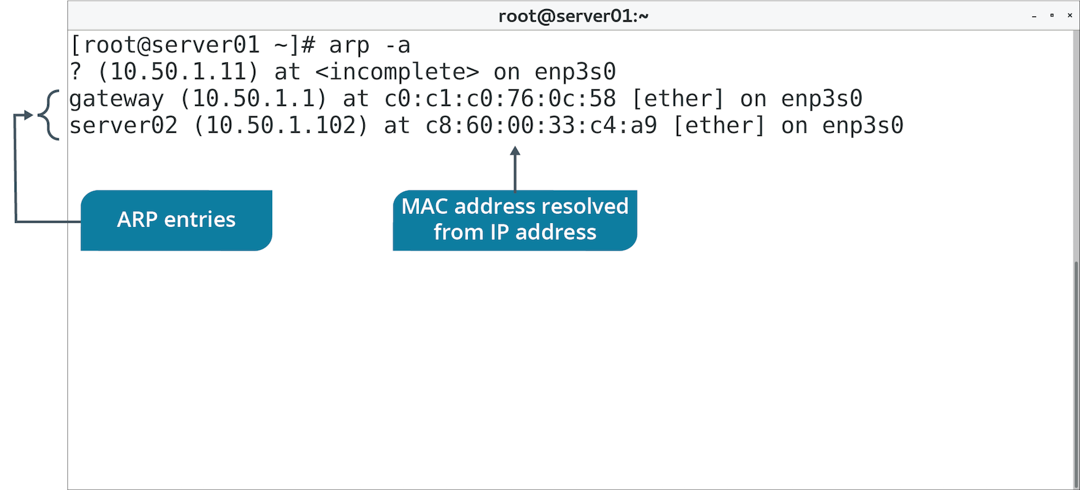
The arp Command (Slide 2 of 2)

Slide 118
The whois Command (Slide 1 of 2)
Provides info on Internet DNS registration.
Use to learn or verify domain name ownership, contact info, etc.
Examples:
whois google.com
whois ubuntu.com
whois redhat.com

Slide 119
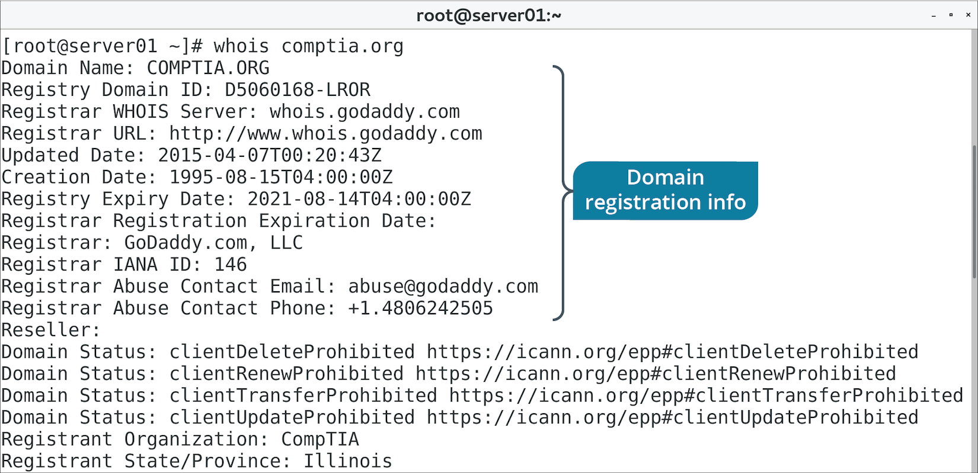
The whois Command (Slide 2 of 2)

Slide 120
Guidelines for Troubleshooting Networking Issues
Narrow the scope of the problem.
Verify IP address config using the ip command.
Diagnose bandwidth issues during slow network performance.
Use iperf to test max throughput if bandwidth is not the issue.
Use general tools:
Use ping to test connectivity.
Use traceroute to understand network between two endpoints.
Use nslookup to test name resolution.
Use ethtool to verify NIC config.
Use virsh to manage KVM virtual machines.
Use iperf to test throughput between endpoints.

Slide 121
Discussing Networking Issues

Slide 122
Activity: Testing the Network Environment
You want to use tools to better understand Develetech's network.
These will help diagnose/solve issues related to:
Latency.
Lack of hostname resolution.
Inability to connect to other hosts.
And more.

Slide 123
Activity: Troubleshooting Networking Issues
Server team has compiled a list of common issues.
Consider the following scenarios and suggest Linux tools and procedures.
You'll make troubleshooting more efficient and effective.

Slide 124
What kind of network services does your organization provide to employees and customers?
Does your organization leverage cloud or virtualization technologies? If so, what resources use these technologies? If not, do you see these technologies being a benefit to the organization?

